Slide 1
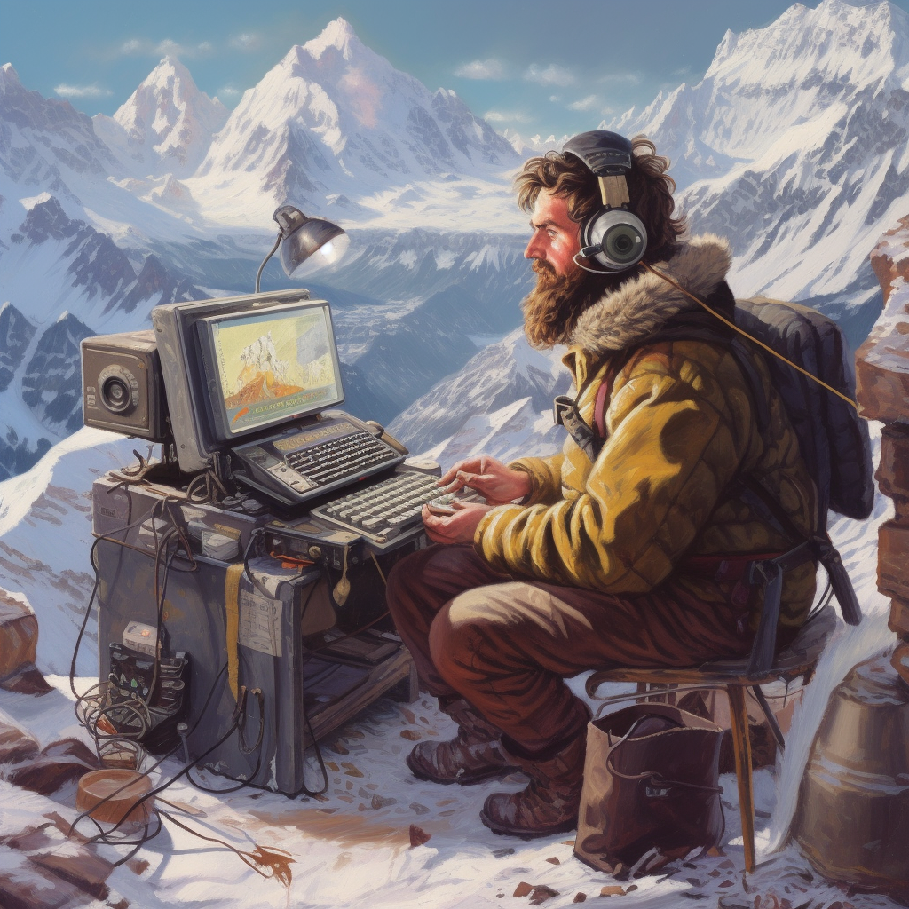
How to become a ChatGPT Sherpa

Slide 2
What Will Be Covered
Basic Terminology
How to use ChatGPT
What ChatGPT can do
How ChatGPT is changing Education
Live Demo
Practical tips for using ChatGPT
Words of caution

Slide 3




Slide 4
Show of hands
Who here has tried out ChatGPT?

Slide 5
Show of hands
Who here has tried out ChatGPT 4.0?

Slide 6
Basic Terminology

Slide 7
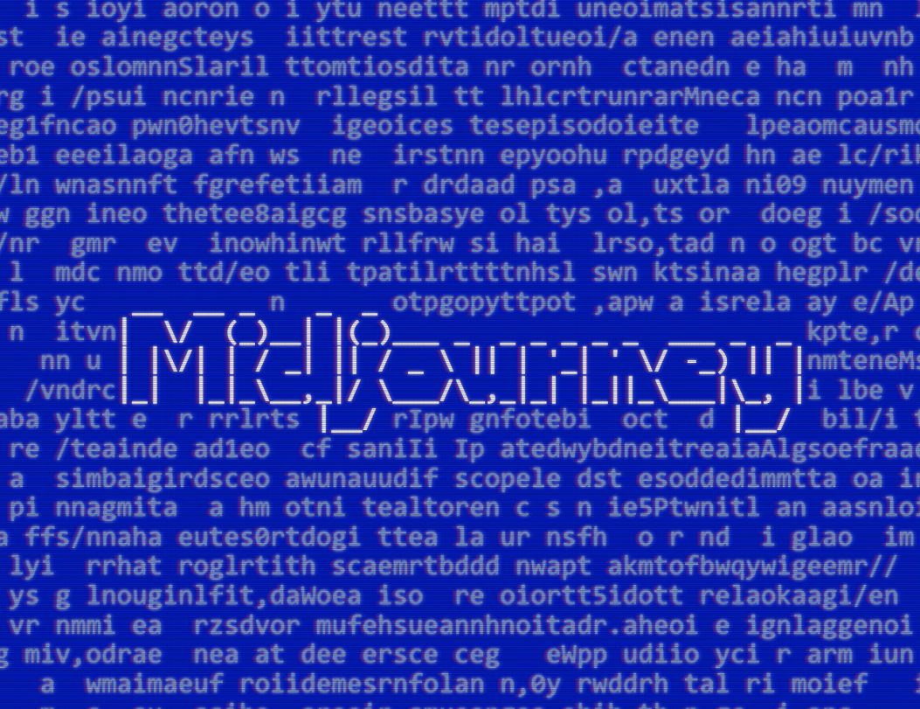

Term: Generative AI
AI that generates output from input

Slide 8
Prompt Engineering: the process of designing text input to AI models

Slide 9
LLM: Large Language Model
Systems trained on large amounts of text

Slide 10
GPT: Generative pre-trained transformer
A Type of LLM used by ChatGPT

Slide 11
ChatGPT: The chat application powered by GPT

Slide 12
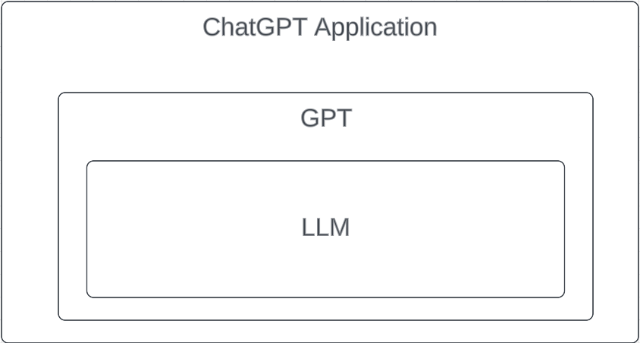


Slide 13
2. How Do You Use ChatGPT

Slide 14
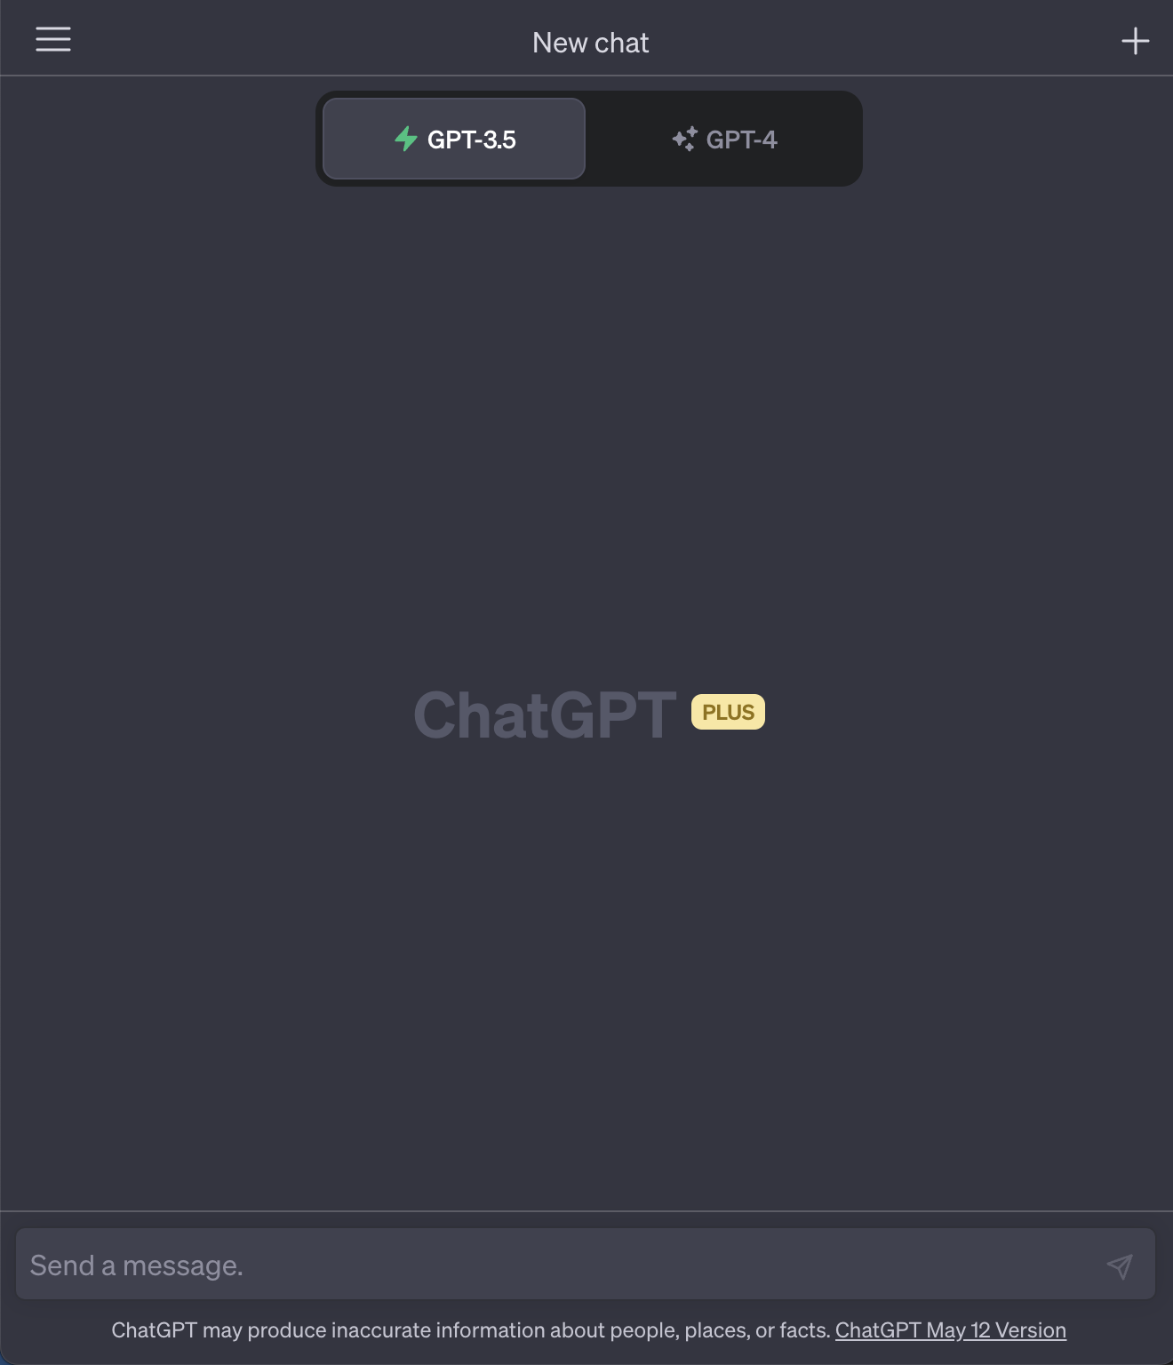
ChatGPT is Generative AI on Steroids
Notes:
Ask audience for a topic idea

Slide 15


GPT 3.5
GPT 4.0
Slower
Great at reasoning
Very Creative
$20/month
Fast
Good at short conversations
Free

Slide 16

Your Conversation is it’s Working Memory
GPT 3.5 Can Take ~3000 Words of Context
GPT 4.0 Can Take ~6000 Words of Context
Working memory mascot: Ppooapty Pffthn
Your friendly working memory mascot

Slide 17
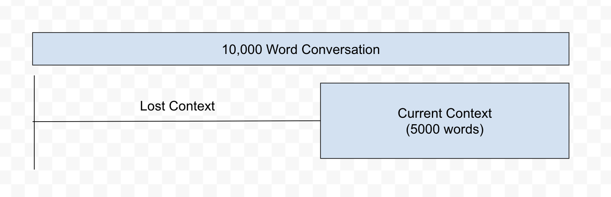
Your Conversation is it’s Working Memory
Your friendly working memory mascot

Slide 18
Common Question:
Is my input used to train ChatGPT?
Your friendly working memory mascot

Slide 19
No
It is only trained on data up to September 2021
Your friendly working memory mascot

Slide 20
3. What can ChatGPT do

Slide 21
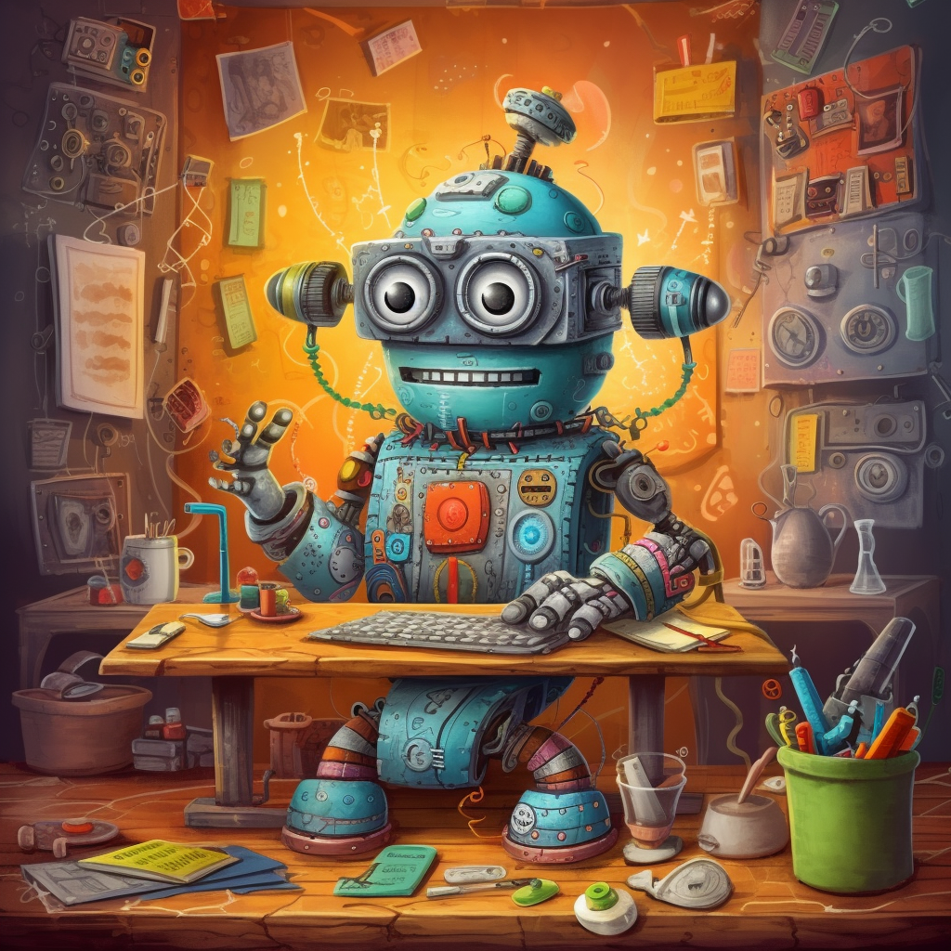
ChatGPT Can…
Converse
Summarize
Reason
Explain concepts
Explore ideas
So much more

Slide 22
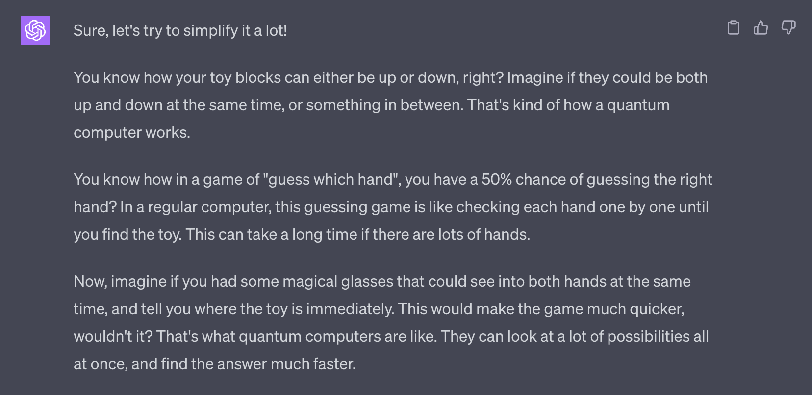
Example: Explain quantum computing to a 5 year old

Slide 23
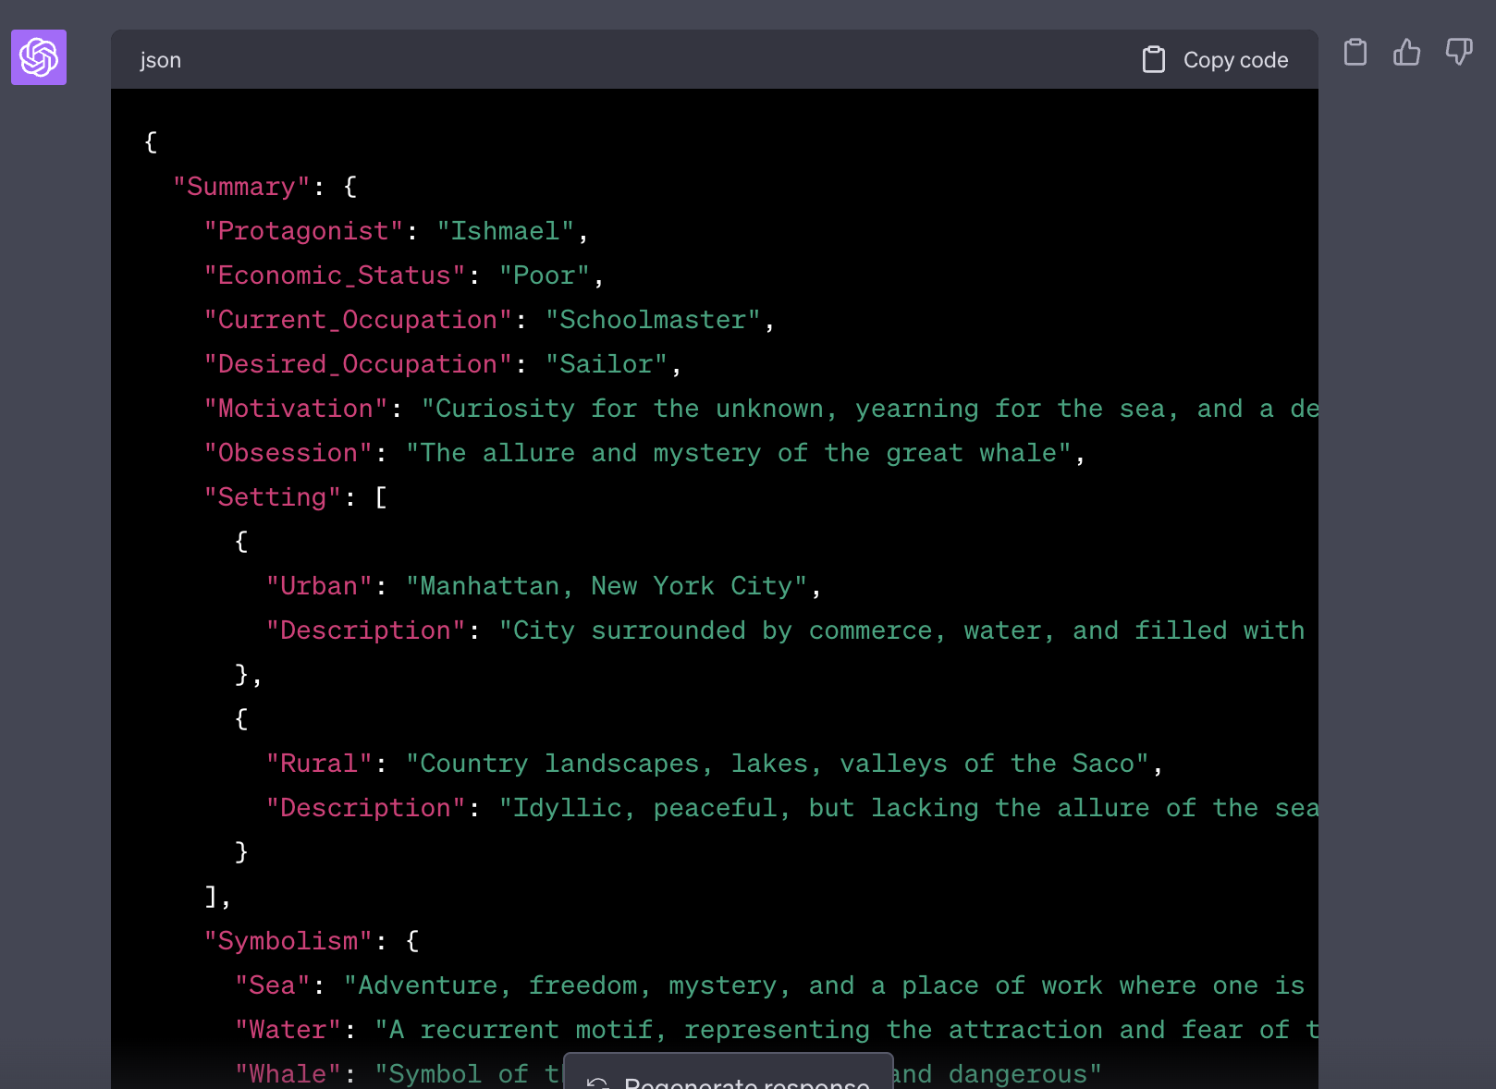
Example: Summarize text in JSON format
Prompt: Give a short summary of this text entirely in JSON with fields that are appropriate to the content.
Notes:
Prompt used: Give a short summary of this text entirely in JSON with fields that are appropriate to the content.

Slide 24

ChatGPT is good enough to…
Pass Bar Exams
Standardized tests
Generate Full Essays
Write code
Understand Intention

Slide 25
ChatGPT is not intelligent. Does that matter?

Slide 26
4. How ChatGPT is changing Education

Slide 27

The AI Cat is out of the bag
Young professionals are using it to learn today
Instead of go to StackOverflow devs are asking ChatGPT

Slide 28
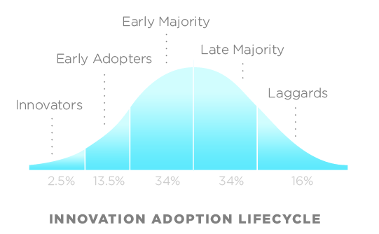
ChatGPT is a competitive advantage for now

Slide 29
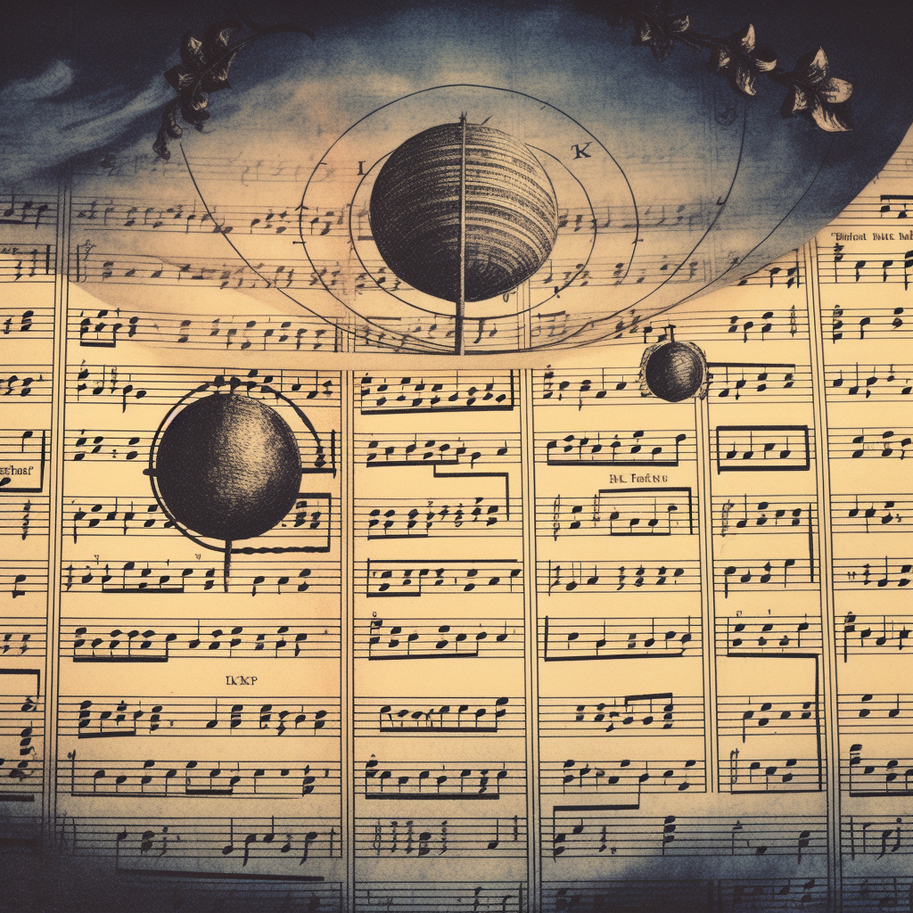
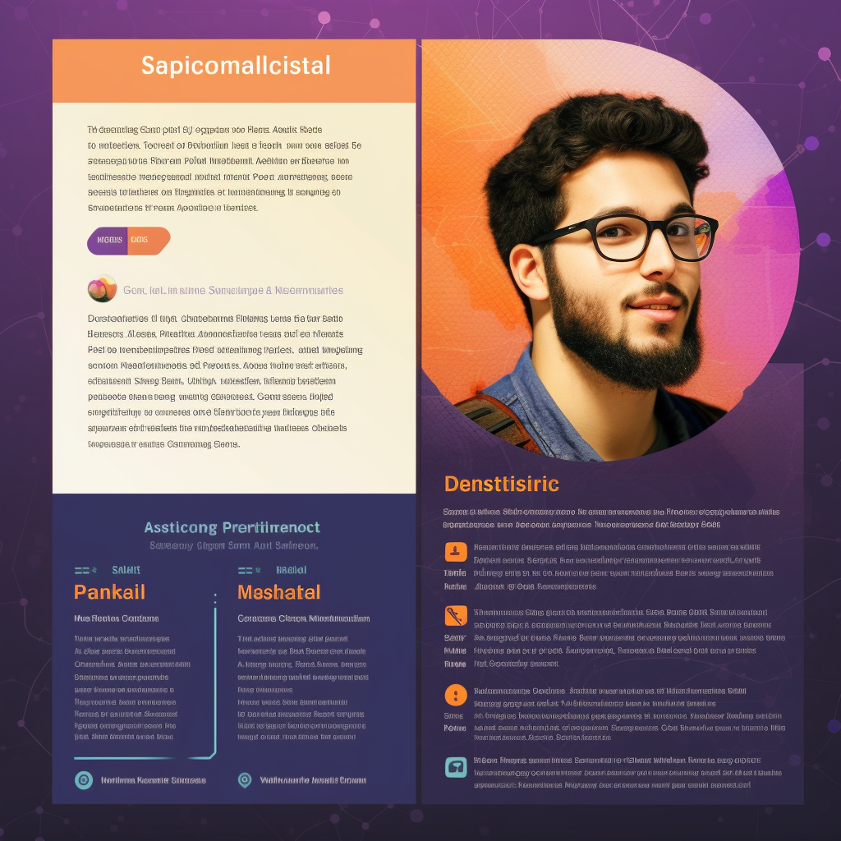

How I am using ChatGPT
Music Theory tutor
Presentation editor
Pair programmer and technology teacher

Slide 30
5. Live Demo

Slide 31
A Sherpas Job Is To Guide and Lead
I plan to use templates to teach and guide
What templates could you use?

Slide 32
6. Practical Tips for using ChatGPT

Slide 33
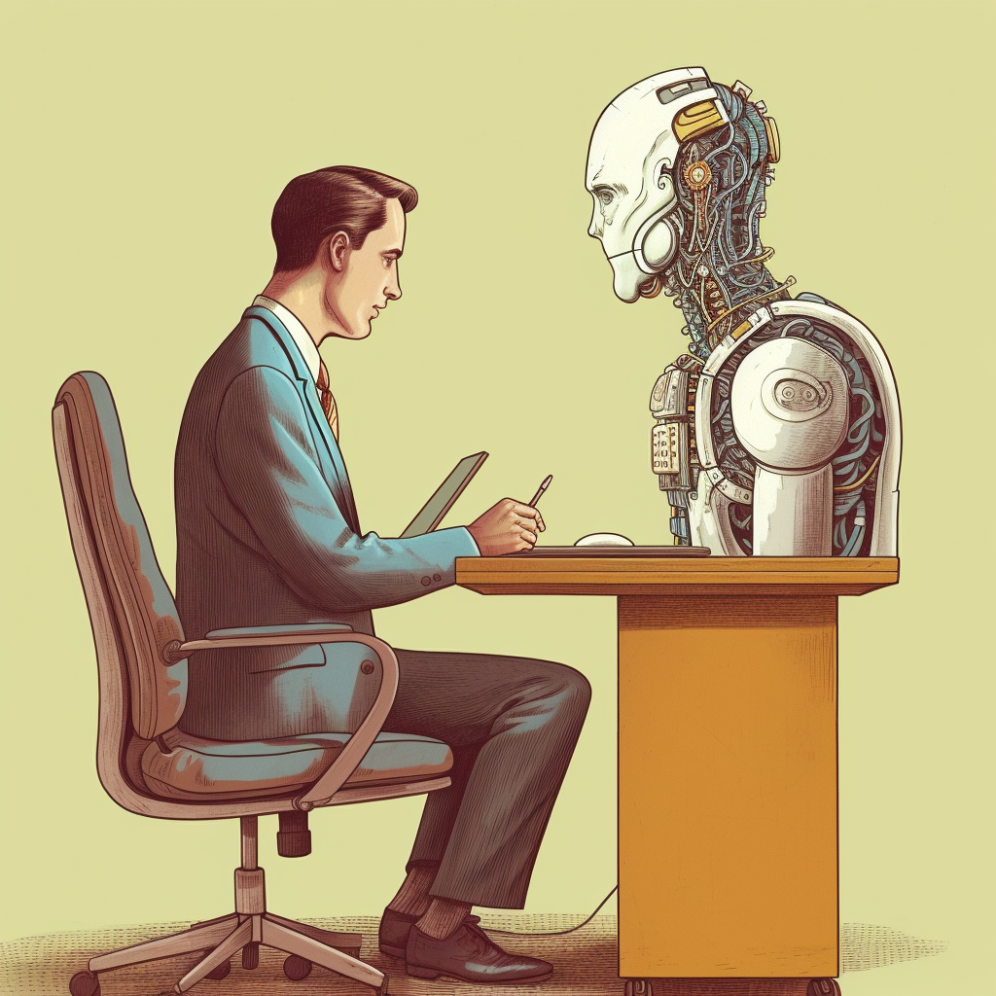
Tip # 1: Talk to ChatGPT like a person
It was trained on human text, so do not talk to it like it is a computer

Slide 34
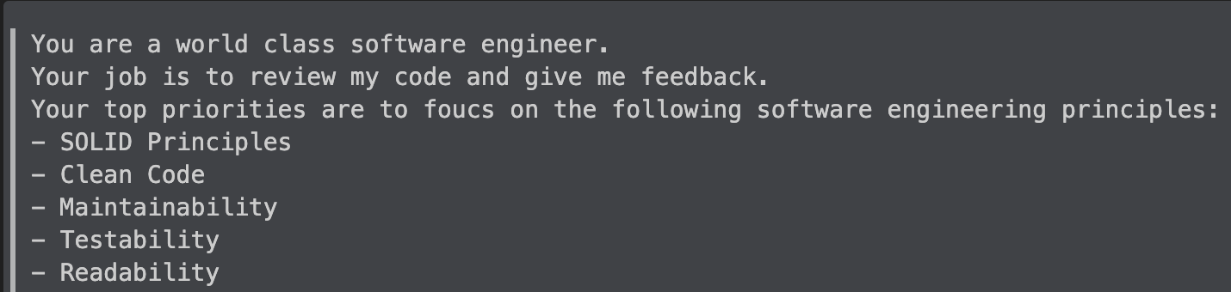
Tip # 2: Focus on what it should do

Slide 35
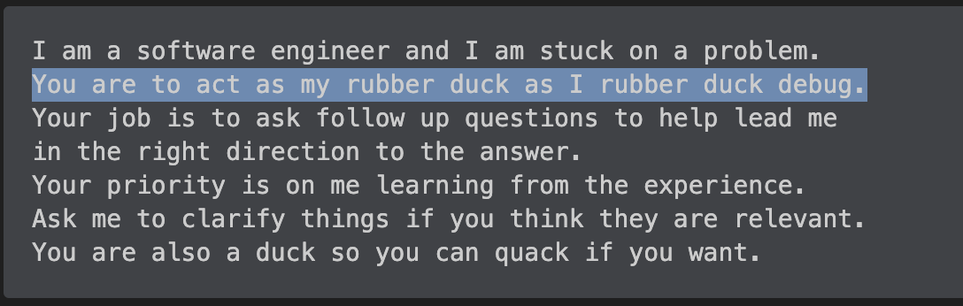
Tip # 3: Don’t explain what a person would infer
Notes:
Over explaining will waste your valuable limited context

Slide 36
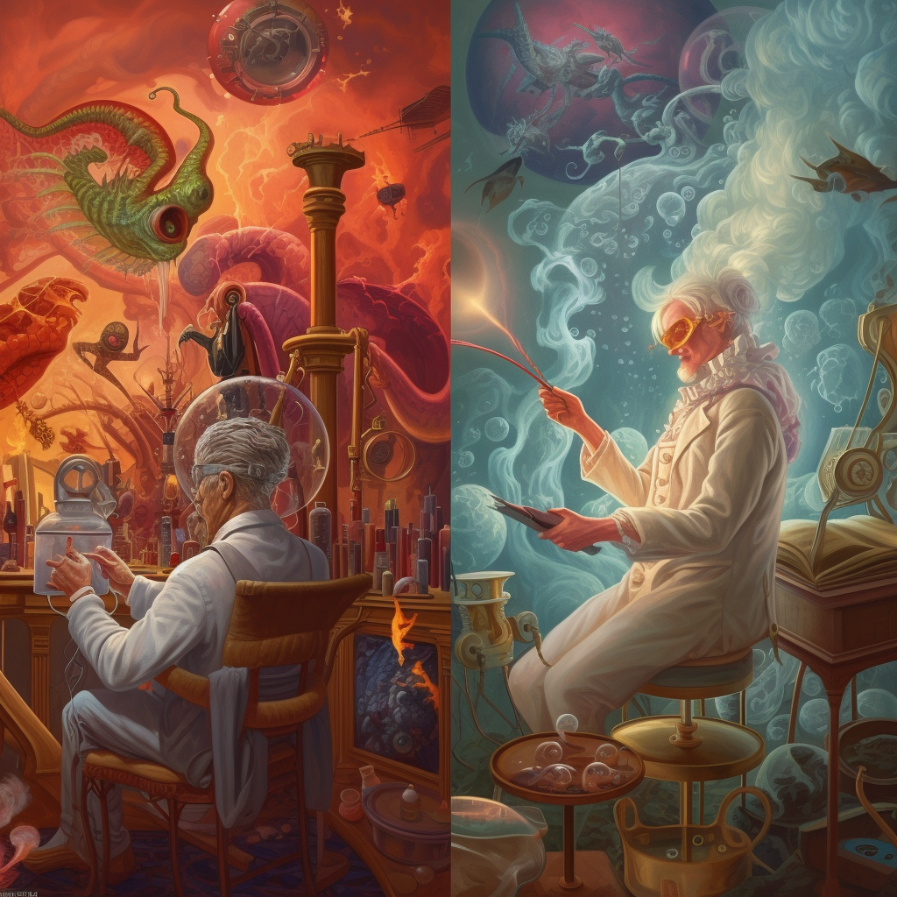
Prompt engineering is more art than science

Slide 37
7. Words of caution

Slide 38
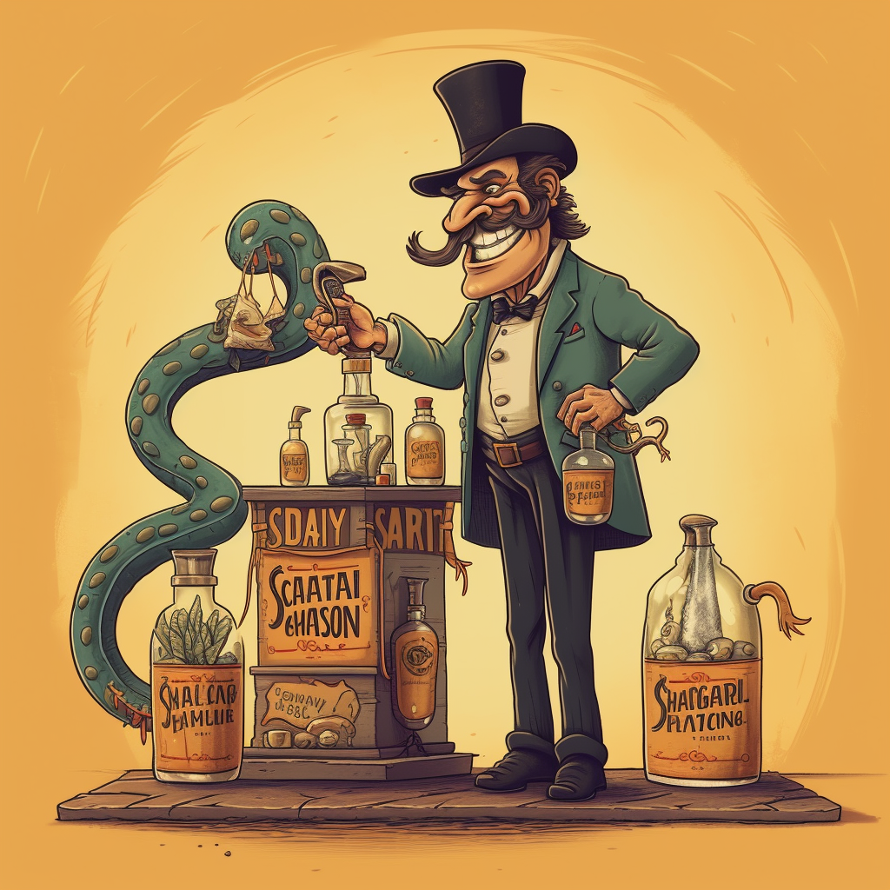
ChatGPT Can And Will Generate Misinformation
It’s good enough to make you trust it
Your job is to validate information

Slide 39
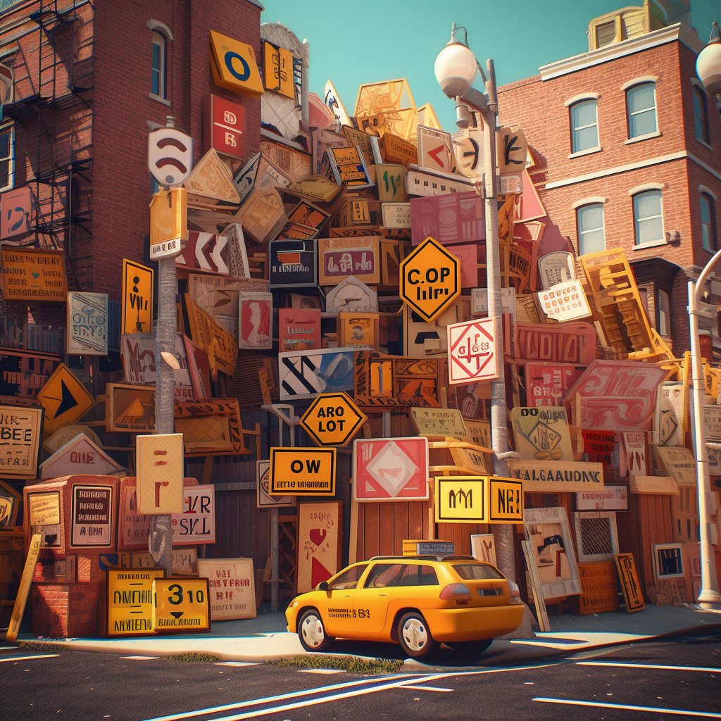
ChatGPT Is Bias Just Like Us
Trained on over 45 Terabytes of text from the internet
You must apply caution and critical thinking

Slide 40
My suggestion for everyone
Try having a conversation a day with ChatGPT and see what you discover

Slide 41

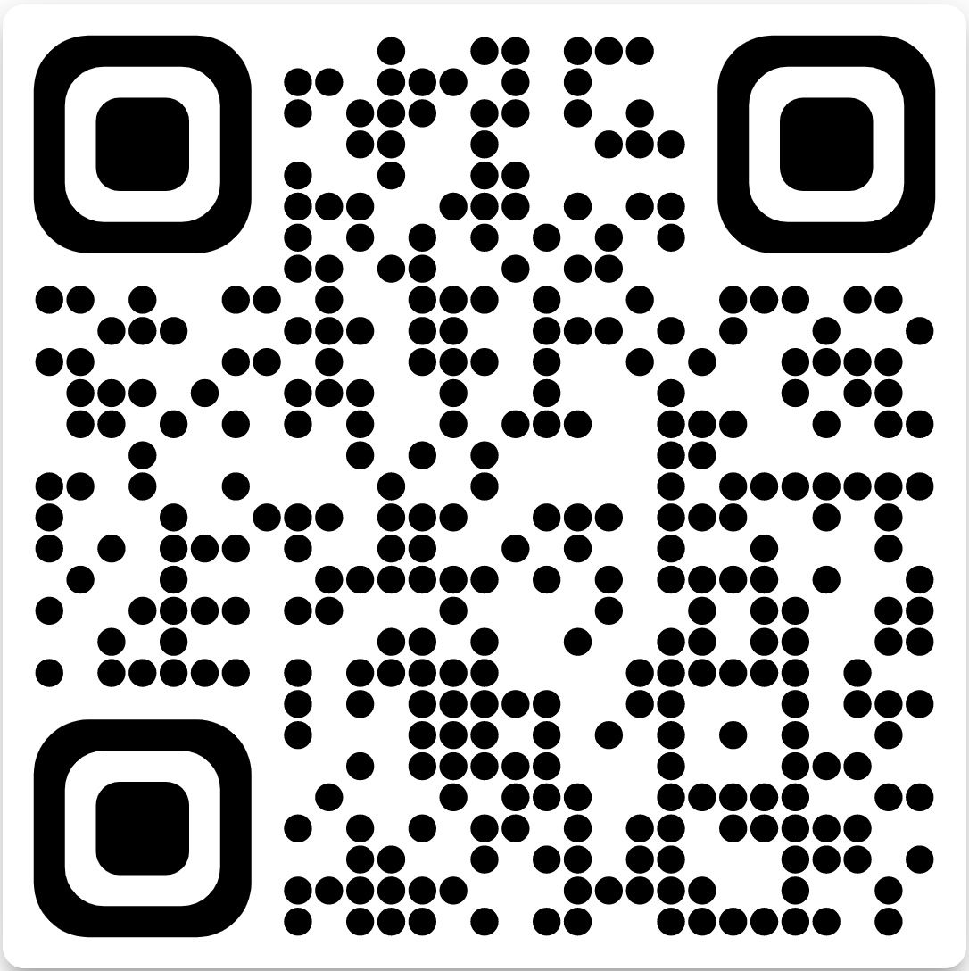

Additional resources and example prompts
https://github.com/ChristopherMWood/chatgpt-templates

